Slide 1
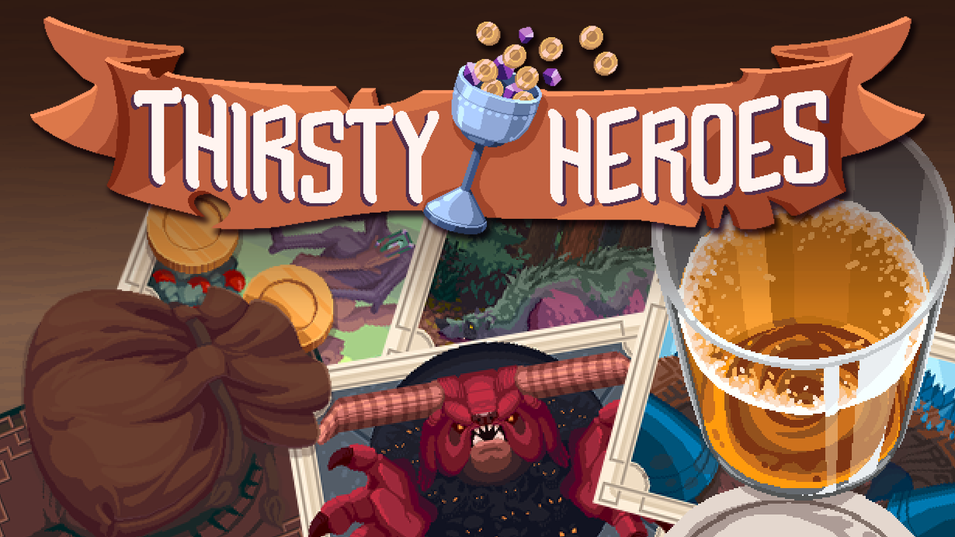
The approachable deckbuilding dungeon crawler
for when you need a quick escape!
💿 PC, Switch, Mobile 📅15 months 💸 $246K
View Trailer (1:00)
⬅ Play Soundtrack

Slide 2
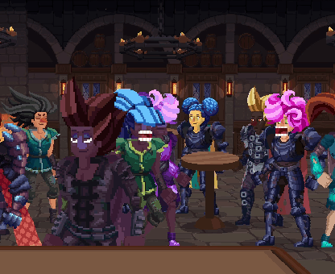
Market Opportunity
The casual/midcore market for light-hearted dungeon crawler roguelikes is under served.
Our Game
Manage a tavern of heroes, serving drinks to power them through dungeon crawls for the King's benefit.
Quick, bingeable sessions
Low pressure
Simplified design
Story-rich
Finishing Up
🚀 50% development to go
📅 15 months 💸 $246K

Slide 3
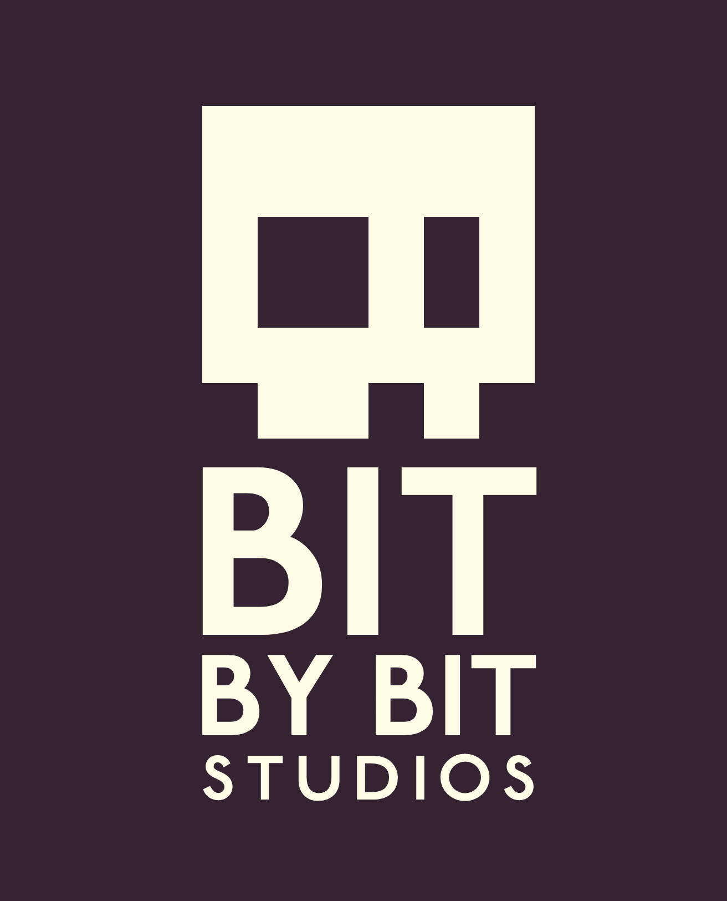
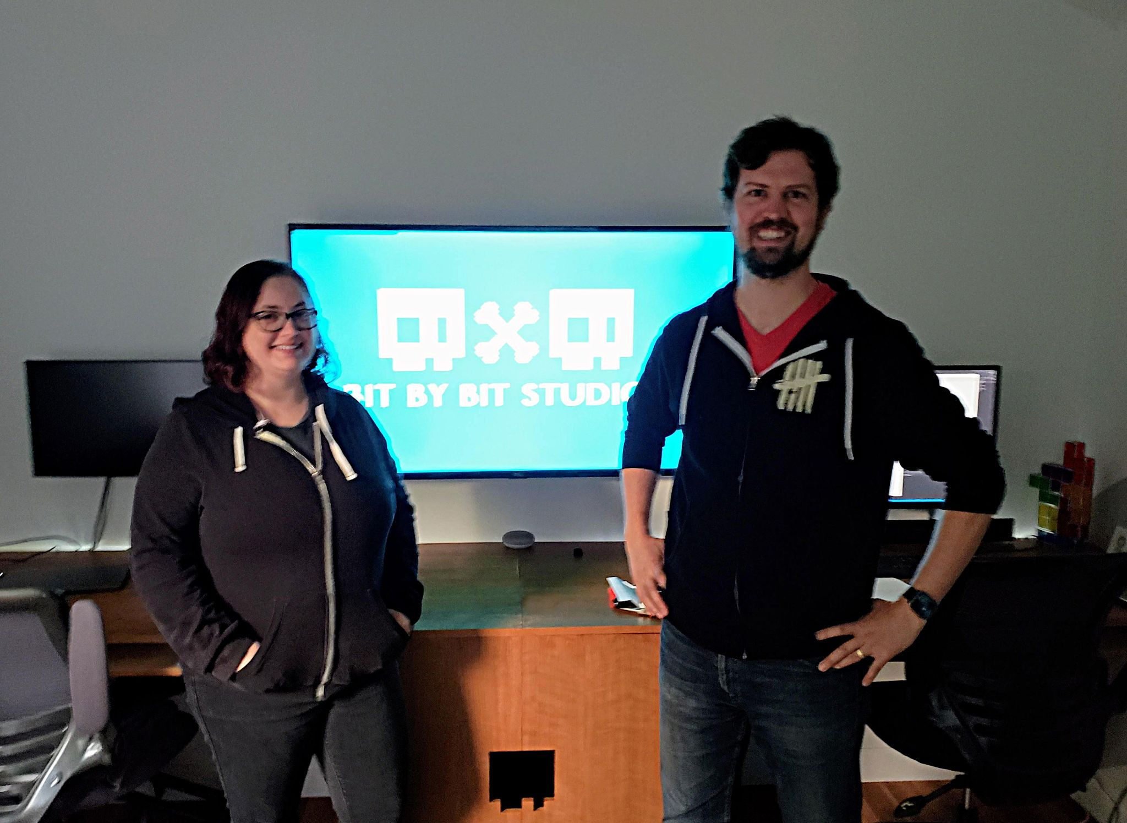
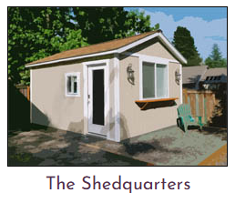
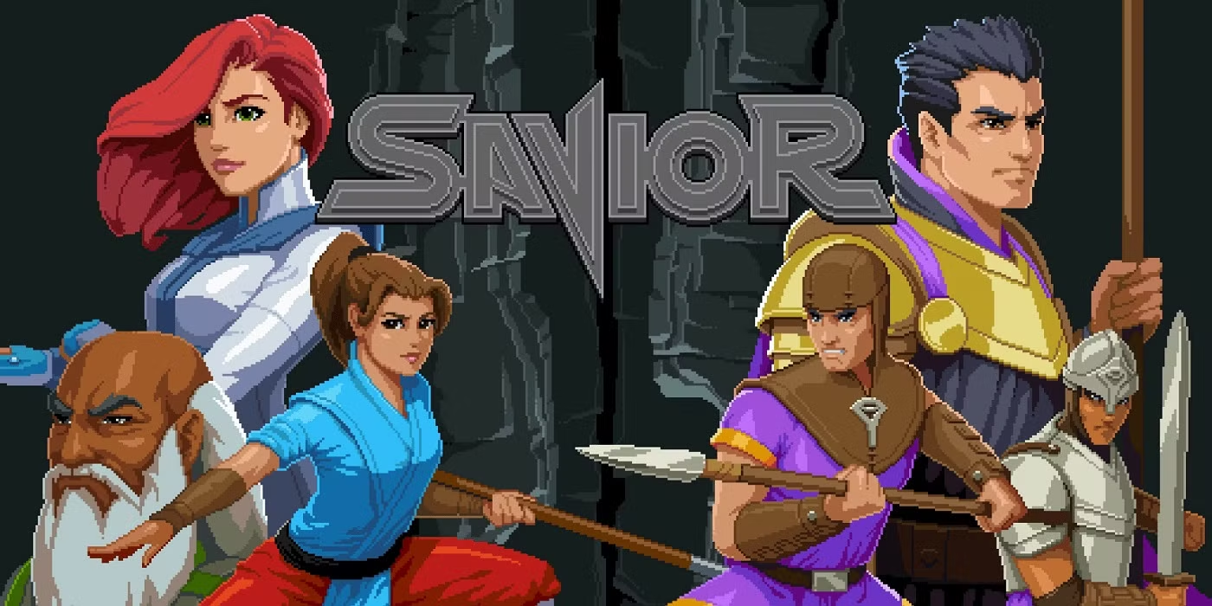
Bit By Bit Studios, LLC
Established 2012 Portland, Oregon USA
Professional duo with decades of experience and 15 years of collaboration.
Sean Sanders
Programming
Design
Business Admin
Kelly O'Donnell
Art
Design
Support
Experience (Zynga, Keywords Studio)
Tomb Raider Series
Tony Hawk Series
Minecraft Legends
FarmVille
Notable Projects
Fiz: The Brewery Management Game
• Released 2014 • iOS/Android
• 4.4/5 Store Rating • 200K+ Paid Downloads
Savior
• 2D Metroidvania • PC (Steam)
• Contract 2022-2024 • In development

Slide 4
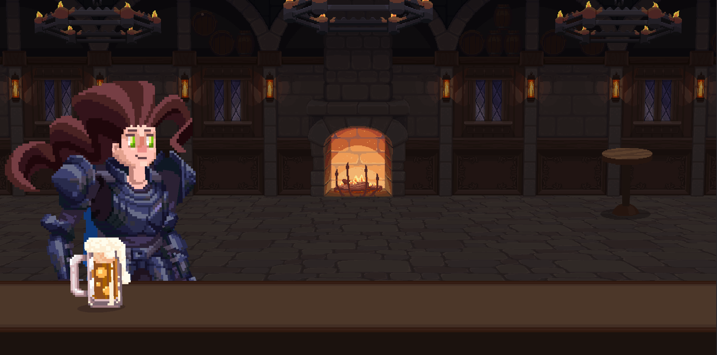
Thirsty Heroes Design Overview
"I want to play Diablo 4 but…"
"I don't have time."
"It looks too complicated."
"I'm not in the mood for a dark theme."
Answer: Evoke the feeling of loot-driven ARPG, adapted to simplified roguelike so it's consumable for busy gamers or newcomers to the genre.
Design Focus
Keep it Simple
Accessible RPG Mechanics
Lite Deckbuilding
Turn-Based Combat with Rock Paper Scissors

Slide 5
1. Keep it Simple
Keep essential dungeon crawler elements
Equip hero
Crawl dungeon
Get loot
Lose the rest
🚫 Inventory / sorting dropped loot
🚫 Branching dungeon paths
🚫 Hero / team management

Slide 6
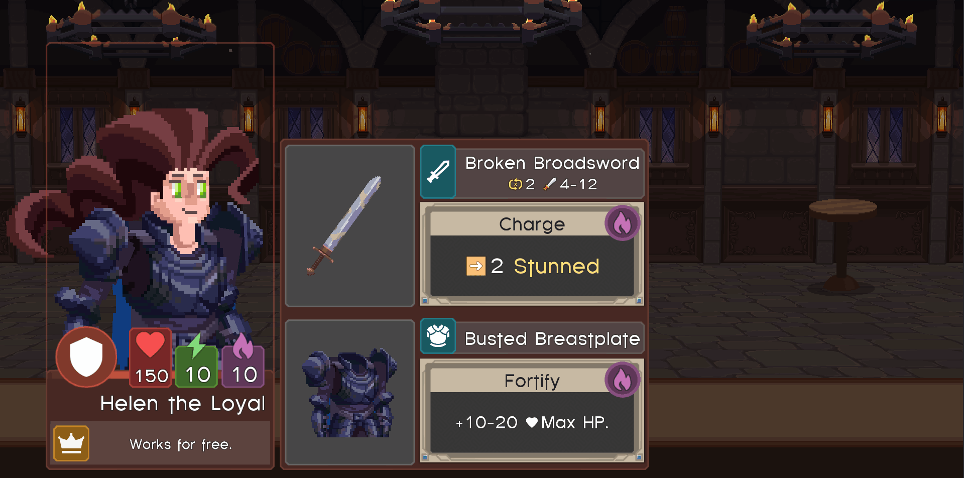
2. Accessible RPG
Hero design distilled to the essentials.
Result: Variety without analysis paralysis.
3 Hero Attributes
2 Inventory Slots
1 Passive Ability

Slide 7
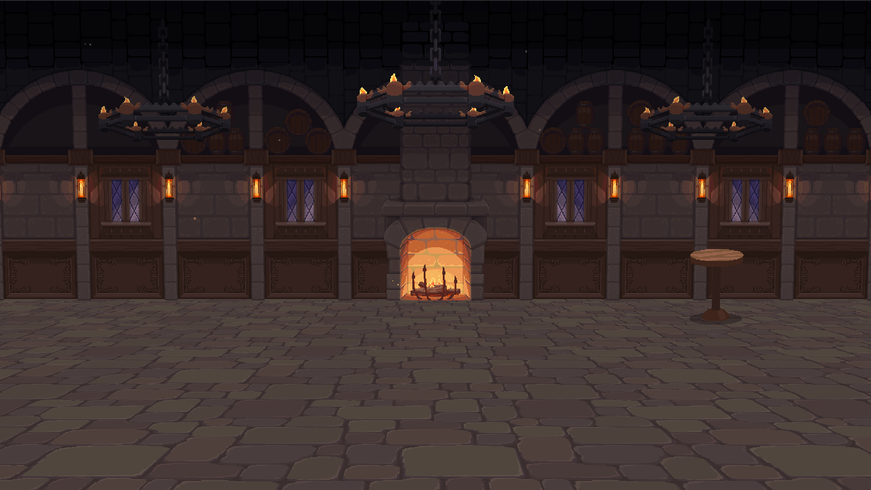
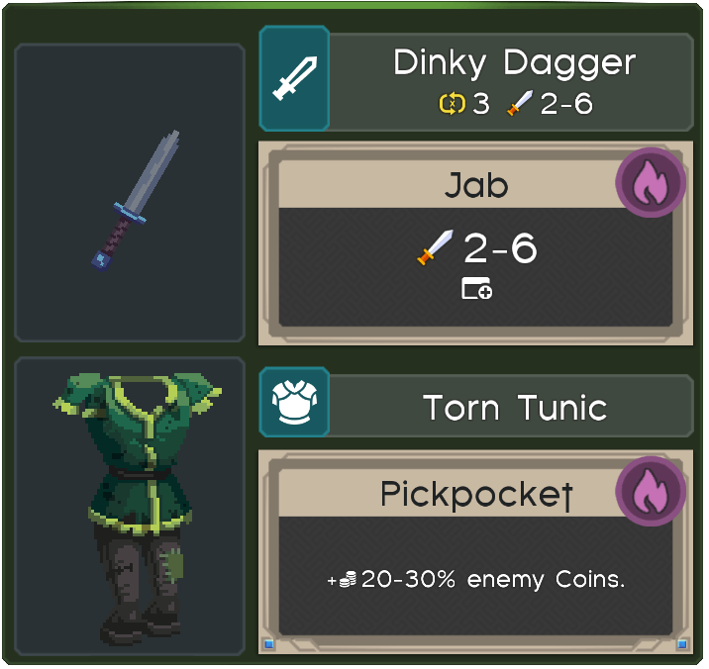
3. Lite Deckbuilding
Deck building with many cards is fun, but complex.
Simpler approach: generate deck during combat.
Start with 10 regular Attack cards.
During combat, roll hero's Skill attribute.
Success = gain Skill Card from weapon/armor.
Skill Cards are removed from deck after use.
Results:
Skill cards are weightier and more exciting.
Regular cards can be played quickly without much thought, entering RPS flow state.

Slide 8
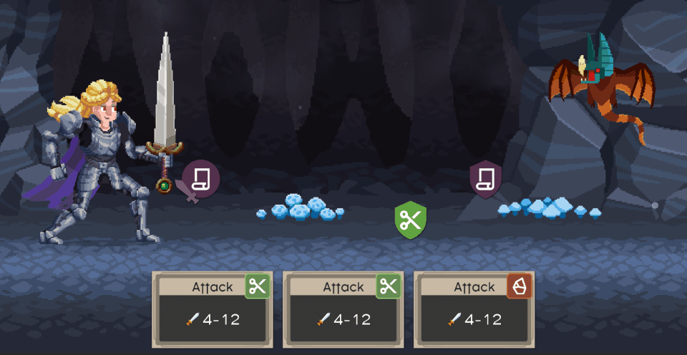
4. RPS Combat
Enemy shows potential Attacks and Defenses as Targets.

Slide 9
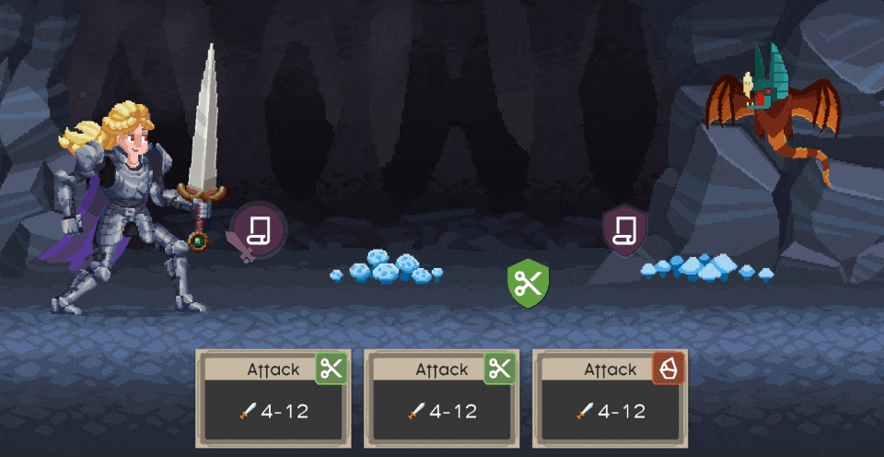
4. RPS Combat
Player drags their card to a target, it resolves based on Rock/Paper/Scissors rules.
Playing against defense targets performs an attack.

Slide 10
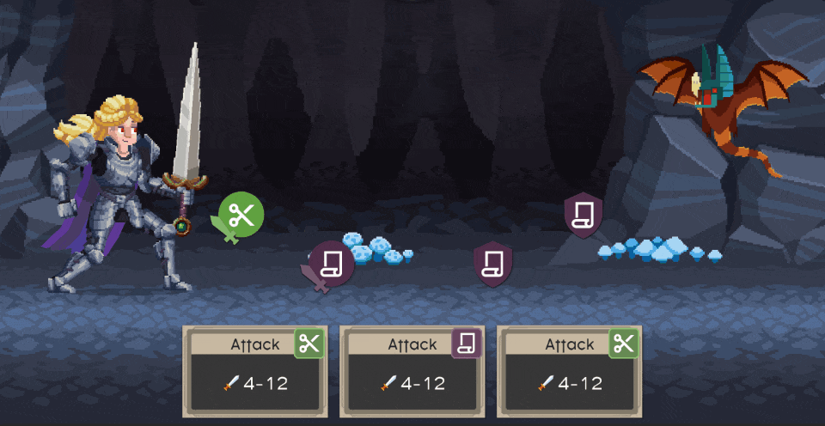
4. RPS Combat
Playing against attack targets cancels the enemy attack.

Slide 11
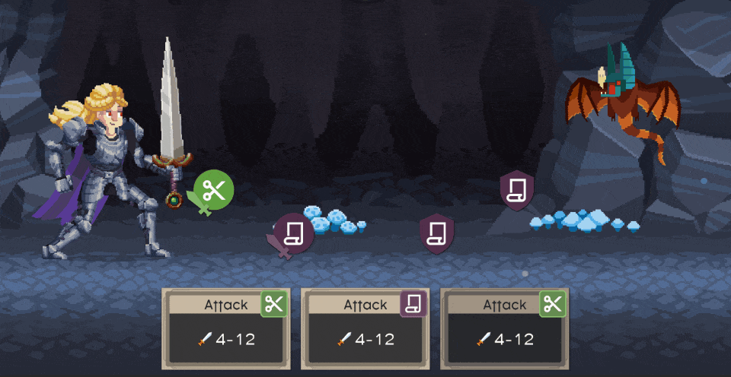
4. RPS Combat
Innovation: Instead of waiting for enemy turn, player handles defense and offense simultaneously.
Result: Strategic choice + rapid playing = flow state (as in match 3 or Tetris).

Slide 12
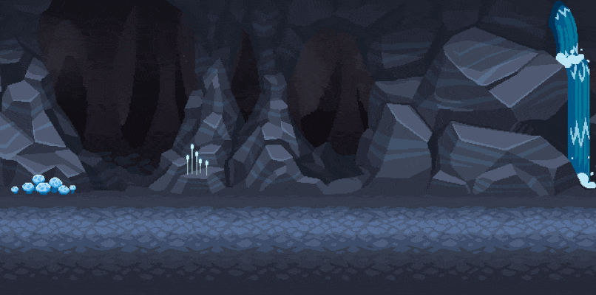
Game Loop
View Map, Choose Hero | Serve Empowering Drinks | Crawl Dungeon | Upgrade and Repeat

Slide 13
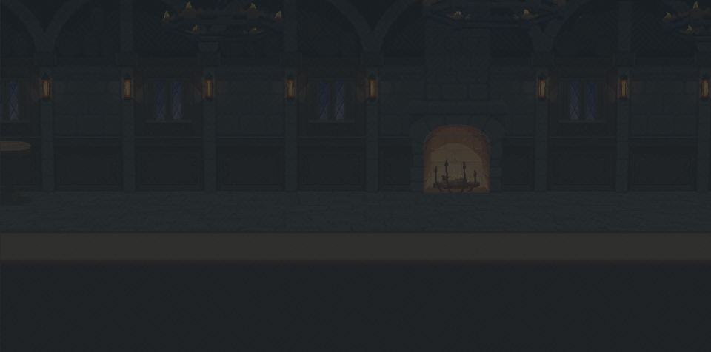
Game Loop Step One
Linear dungeon layout: no mazes or getting lost.
Simplified heroes are easy to compare.
View Map, Choose Hero | Serve Empowering Drinks | Crawl Dungeon | Upgrade and Repeat

Slide 14
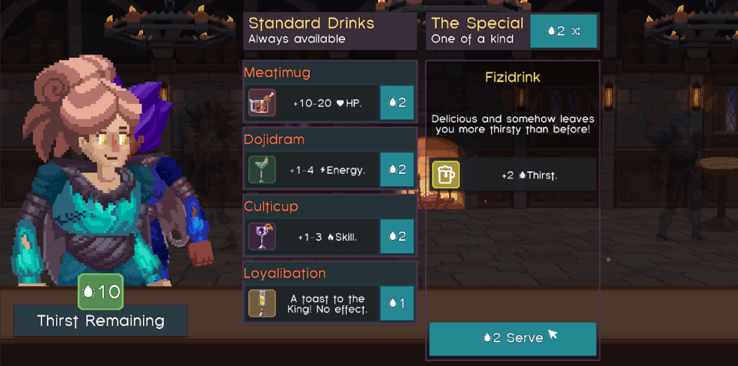
Game Loop Step Two
Spend Thirst Points on Standard drinks to buff hero for one dungeon only.
Or gamble on random Special drinks - they can be permanent and add variety.
Good rolls here can make for a record breaking run!
View Map, Choose Hero | Serve Empowering Drinks | Crawl Dungeon | Upgrade and Repeat

Slide 15
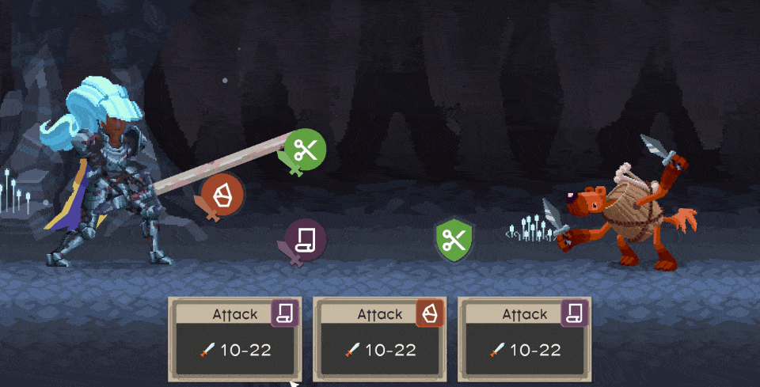
Game Loop Step Three
About 3 minutes per dungeon crawl, with adjustable difficulty (more risk = more reward).
6 distinct environments, each with 10 various encounters (60 total).
View Map, Choose Hero | Serve Empowering Drinks | Crawl Dungeon | Upgrade and Repeat

Slide 16
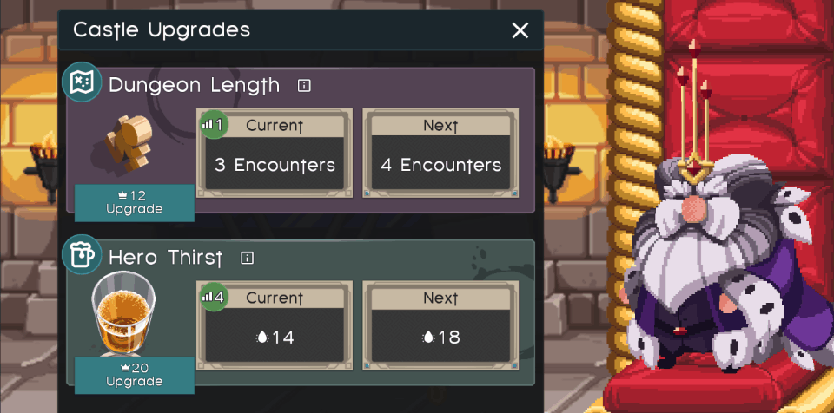
Game Loop Step Four
20 purchasable upgrades, many scaling infinitely.
Unlock new story and quests by getting higher scores in dungeons.
View Map, Choose Hero | Serve Empowering Drinks | Crawl Dungeon | Upgrade and Repeat

Slide 17
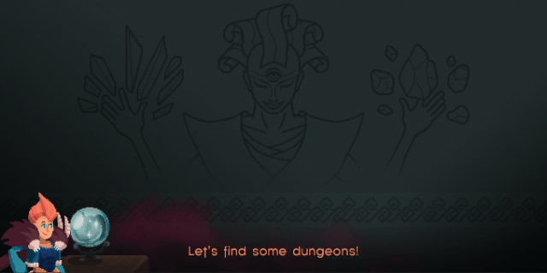
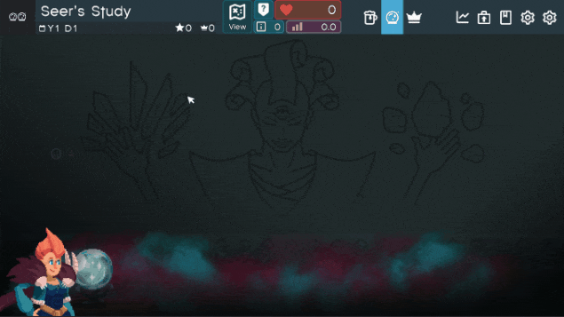
Feature: Create New Dungeons
Scouting
Move token across map to discover new dungeons, quests, and loot.
Upgrade capabilities to expand map and discover new dungeon environments.
Divination
Players build dungeons by selecting encounter cards 3 at a time.
Dungeons can be tailored to suit Quest objectives and hero strengths.

Slide 18
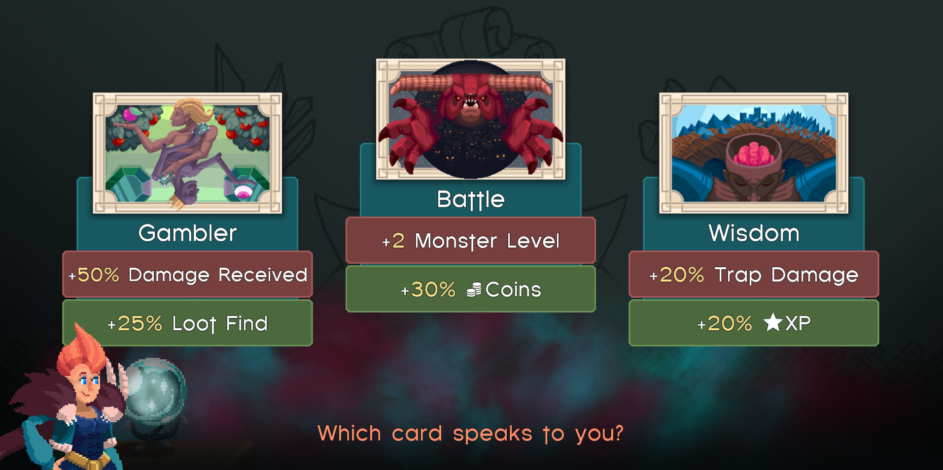
Other Features
Tarot Reading / Dungeon Modification
After hero drinks phase and before crawl, augment dungeon to increase difficulty.
Players balance risk and reward.
Dungeon Relics
Procedurally generated loot that applies global upgrades to your castle.
Increase gold amount
Increase hero Thirst
Increase weapon damage

Slide 19
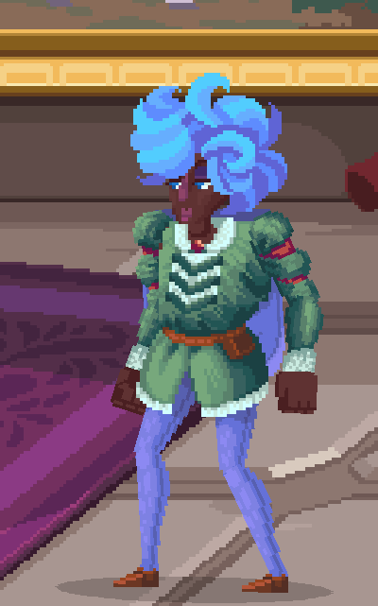
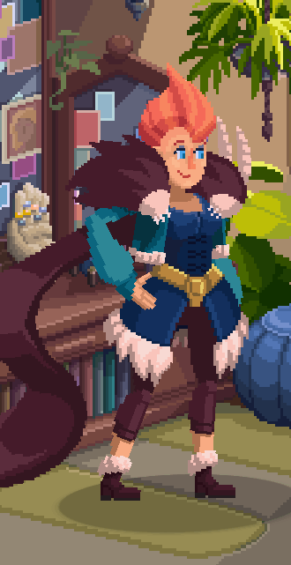
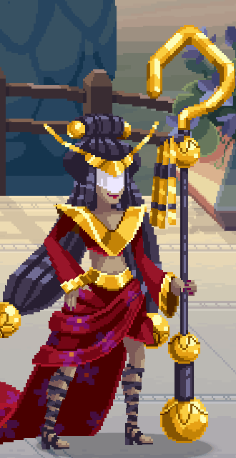
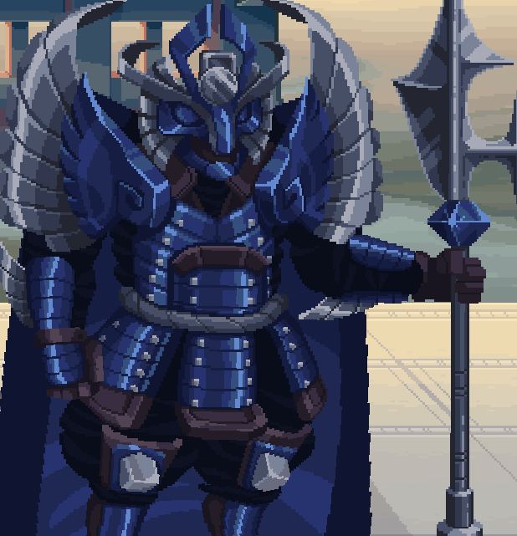
Story
Read below character profiles for plot details.
Full plot outline may also be found in this doc.
Story Scope
20 hours story gameplay (infinite replayability otherwise)
10 main story quests, 20 side quests
50-80 written dialogue lines per quest (~2,000 total)
Player Character
Beth the Seer
The King
Empress Jade
Greiz, Imperial Guard
Even though you are new to the kingdom, the King appoints you Quartermaster and demands you increase the holdings in the royal vault right away, or else! You are not a fighter, so you hire heroes to do the work for you. Though a silent protagonist, player choices for PC dialogue impact responses from other characters. | Beth serves as your lifeline at the castle, where she has long served. She is kind, witty, and helpful. And powerful, too - although she doesn't take enough credit for it. As Royal Seer, she uses her powers of foresight and fortune telling to aid you in planning for dungeon crawls. She also helps you avoid the King's ire. | The King is the heel of the story. He's quick tempered and often alludes to drawing and quartering your predecessors, though his diminutive stature and childlike outbursts make it hard to take him seriously. He's always rushing to get back to his private Council Chambers for "important business", but it's later revealed he has been playing with stuffed animals and trains all along. | The unwitting villain, Jade's character explores the questions, "What if an overconfident 16-year-old was given unchecked power? What if they were surrounded by sycophants and had little idea of the world they ruled?" As the newly ascended Empress of the neighboring nation, Jade seeks powerful dungeon items for virtuous reasons, but with disastrous results. Players endeavor to find the loot first in order to avert disaster. | As Imperial Guard to her father, Greiz has known Jade since she was born. He became her solemn guardian once she ascended the throne, performing his duties with a paternal dedication. A man of few words, he conveys his disapproval with a subtle tightening of his halberd's grip if someone dares speak disrespectfully to the Empress. Near the end of the story, he reveals the depth of his devotion by standing defenseless against a possessed Jade.

Slide 20
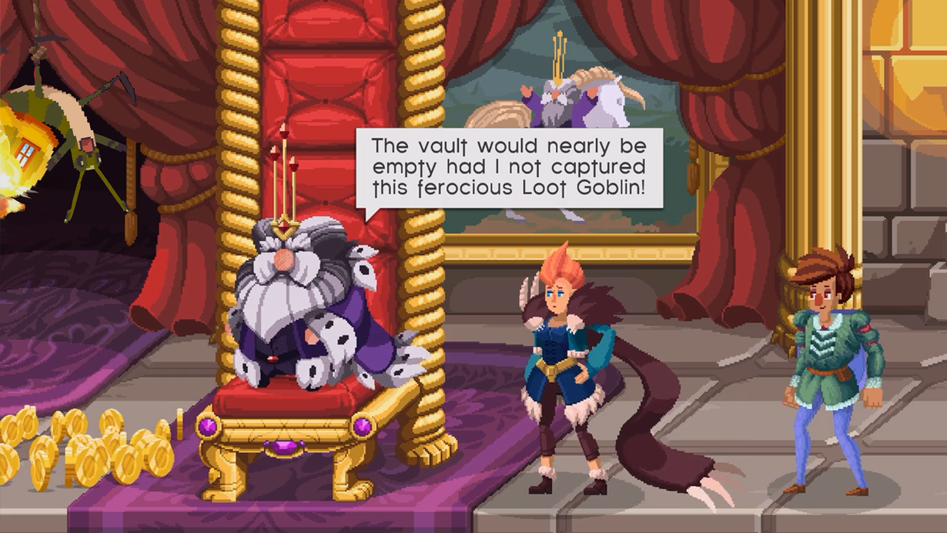
Story Cutscene Example

Slide 21
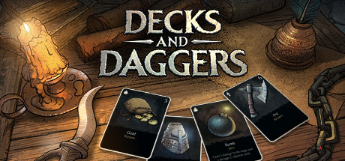
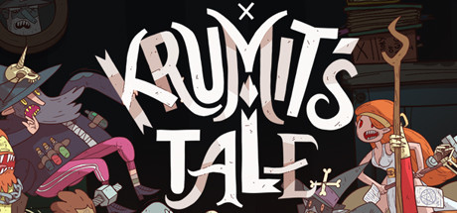
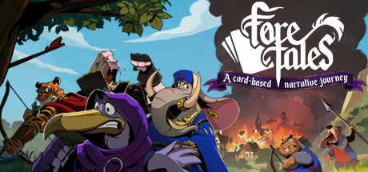
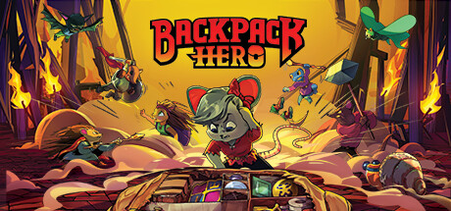
Comparable Games
Game | Decks and Daggers | Meteorfall: Krumit's Tale | Foretales | Backpack Hero
Released | Oct. 2021 | Nov. 2019 (Early Access) July 2020 (Release) | Sept. 2022 (Release) | Aug. 2022 (Early Access) Nov. 2023 (Release)
Steam Price, # Reviews | $12.99 50 Reviews | $14.99 714 Reviews | $19.99 631 Reviews | $19.99 6,650 Reviews
Est. Units using gamalytic.com | 2.2K (Steam) | 23K (Steam) 100K (Mobile) | 21K (Steam) ??? (Switch) | 402K (Steam)
Est. Revenue using gamalytic.com | $20K | $167K (Steam) >$200K (Mobile) | $273K (Steam) ??? (Switch) | $5.5m (Steam)
Notes | 2D Card battler. Dev team of two. Self-published. Similar tone and theme. Nice UI design. | 2D Card battler. Dev team of two. Self-published. Similar tone and theme. Innovative mechanics. | Narrative Card battler. High production value. Design somewhat negatively reviewed. | Turn-based roguelike, pixel graphics, town building. Dev team of two. $200K KS. Streamer traction.
Weaknesses which TH improves upon | No marketing / PR. Each crawl success/failure feels random and not strategy driven. Lacks "just one more game" feeling: no quests/objectives, no random loot drops. | No marketing / PR. Lacking story (shorter game). No Switch port. | Sessions are long and punishing (force replay levels). No infinite play. No mobile port. | Not available on other platforms.

Slide 22
Development Progress - 50%
2021
Production Began
Completed Work
• Finding the Fun
• Game Loop
• Procedural Generation
• Combat
• 50% Artwork
• 40% Dungeon Design
• 40% Item Design
• 70% Music
2022
Completed Kickstarter ($30K)
2023
Production Paused
2025
Production Resumed
Q2 '26
Target Release

Slide 23
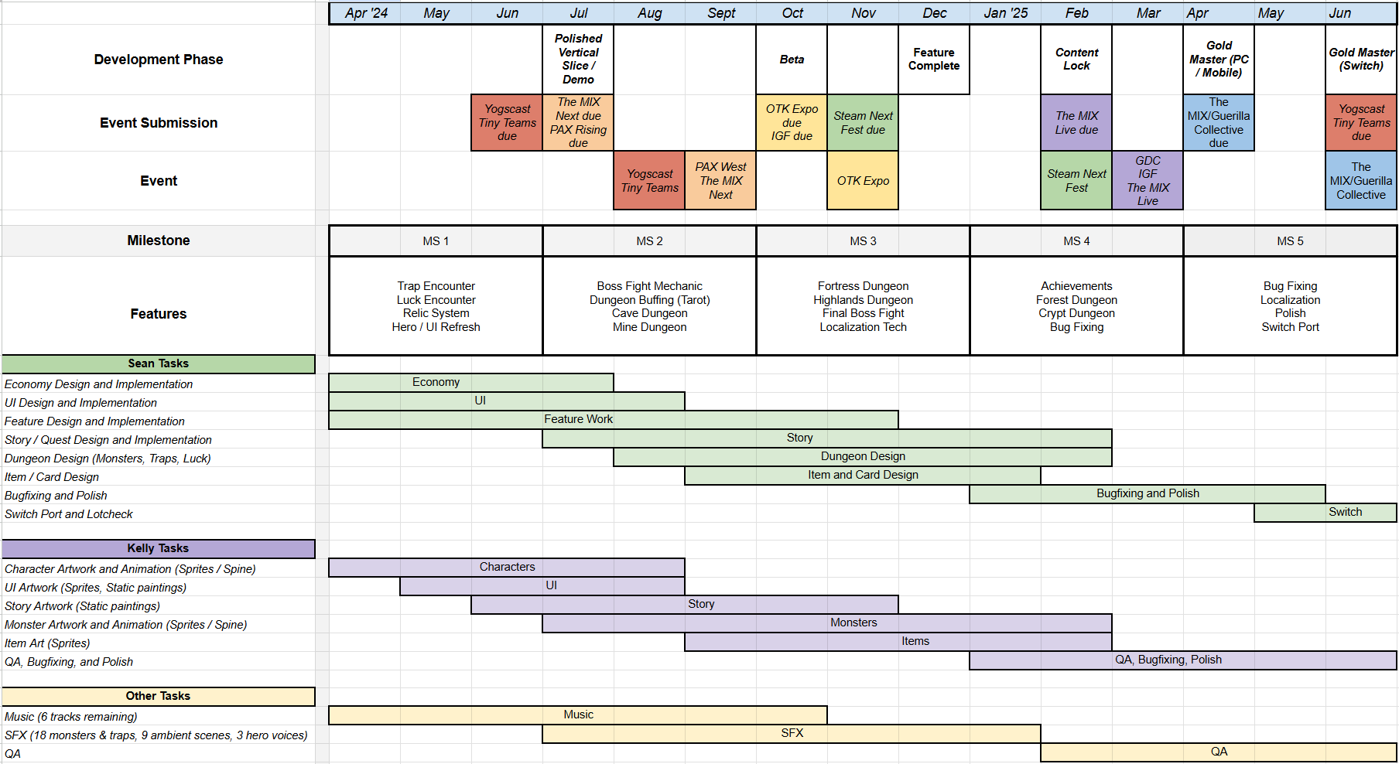
Remaining Production Timeline: 15 months Click to view as spreadsheet

Slide 24
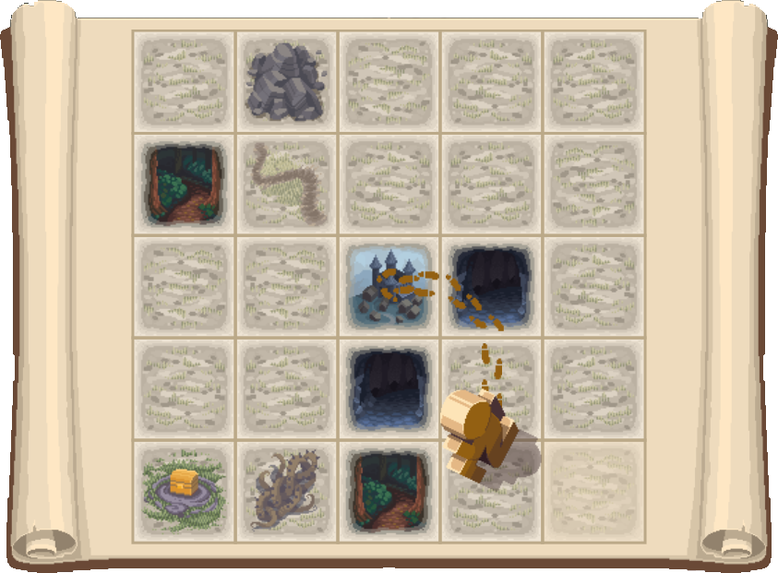
Budget
Funding So Far
Self-Funded (contract work, game royalties) | $287,000
Kickstarter (Net) | $20,000
Spent Total | $307,000
Looking Ahead
Monthly expenses for our team of 2
Funding the Second Half
Total needed to release
Sean Salary + Health | $8,000
Kelly Salary + Health | $7,000
Unity Licenses | $400
Monthly Burn Total | $15,400
Production (15 months) | $15,400 x 15 = $231,000
Composer Fee | $5,000
Sound Designer Fee | $10,000
Total Budget Ask | $246,000

Slide 25
Partnership Needs
Item | Notes
Development Funding | $246K
Market Strategy | Pricing, DLC strategy, platform deals
Promotion / PR | Press, influencers/streamers, social
International Distribution | China in particular.
Localization | China + Japan + EFIGS (+ more?)
QA | Some handled internally.
Values Alignment | Retain IP / creative control. No: MTX, Ads, Blockchain.

Slide 26
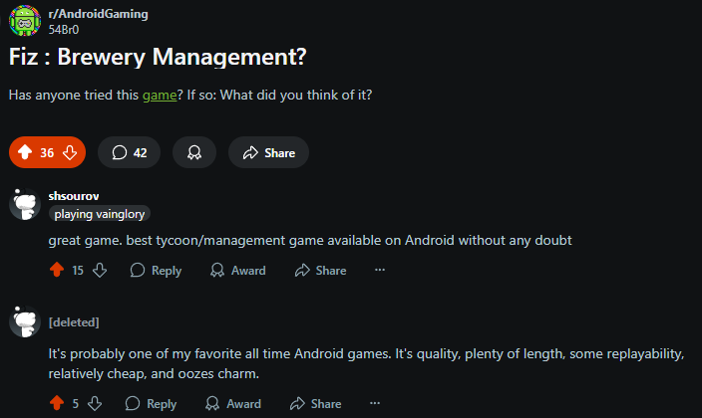
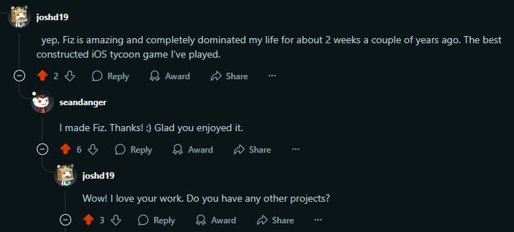
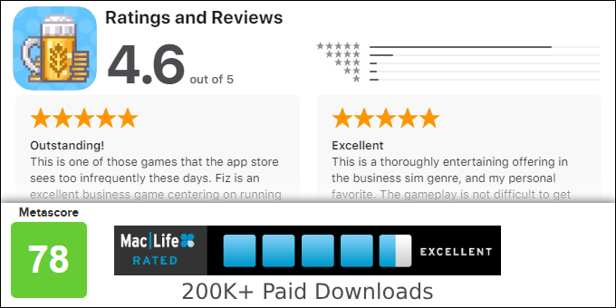
Company Presence
We have self-published a popular game and executed two successful Kickstarter campaigns.
Platform | Users/Followers | Notes
Steam Wishlists | 1,500 | Lots of dry powder here - we haven't released a demo or participated in a festival.
Mailing List | 2,700 | Small audience but high CTR indicative of our quality. 37% open, 7% click through rate.
Fiz Users (Previous Game) | Cur. Installs: 11,000 MAU: 1,000 | Can advertise Thirsty Heroes via in-game news. Organic App Store / store listing links will impact many additional users.
KS Backers | 1,200 | Many super fans and evangelists here.
Discord | 250 | Zero marketing outside of KS. We have an in-server version of the game with weekly leaderboards that players enjoy.
Facebook | 2,000 | Organic growth from our previous game, Fiz.
X / Twitter | 1,000 | Organic growth from our previous game, Fiz.
TikTok | 100 | Created and used only during recent Kickstarter campaign.
Twitch | 60 | Infrequent dev streams. We are experienced doing them and look forward to more engagement as our audience grows.
Even without dedicated marketing efforts, we have cultivated a small but loyal following through personal and earnest engagement.
We have the skills to maintain and grow this audience given the opportunity.

Slide 27
Summary
Thirsty Heroes is fun and has broad appeal.
✔
Accessible design, quick play, and light-hearted story exploit a market opportunity for deckbuilding roguelikes.
✔
Mobile market raises revenue ceiling beyond Steam.
We have a realistic production plan.
✔
Production plan with modest schedule, pace, and scope. Remaining work: mostly adding content to existing loop.
✔
Extensible design allows for future expansion: New dungeons, new items, daily leaderboard, etc.
We are excellent partners to make this game.
✔
We are nice people with proven experience shipping similarly-scoped games.
✔
Our team has worked together for over a decade, with self-publishing success and many happy clients.

Slide 28
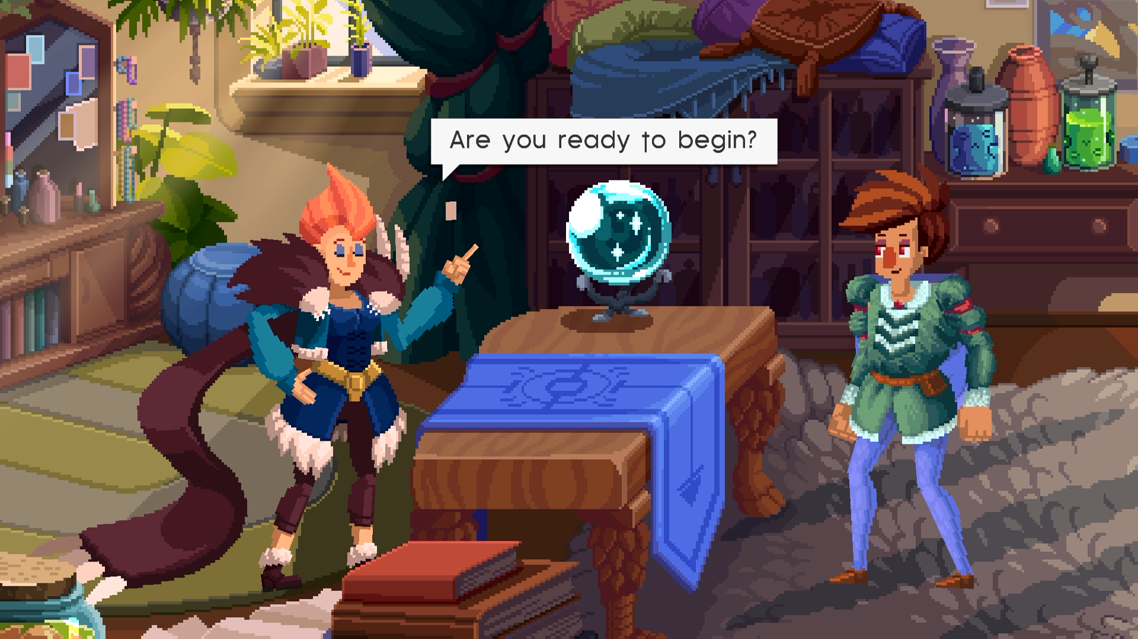
Thank you for your consideration!
This is going to be fun!
Website
https://thirstyheroes.com
Steam
https://store.steampowered.com/app/1247470/
Discord
https://bitbybitstudios.com/discord
Contact Sean
sean@bitbybitstudios.com

